Slide 1
Module 3 Data Science Project: Soccer Data
David Goldstein
dgoldstein24@gmail.com

Slide 2
Project Prompt Question:
Do advanced attacking soccer metrics make for an accurate model to classify players by position?
Implication: If the answer is yes, advanced metrics could be used to determine the most likely or ideal playing position for incoming players from other leagues/teams

Slide 3

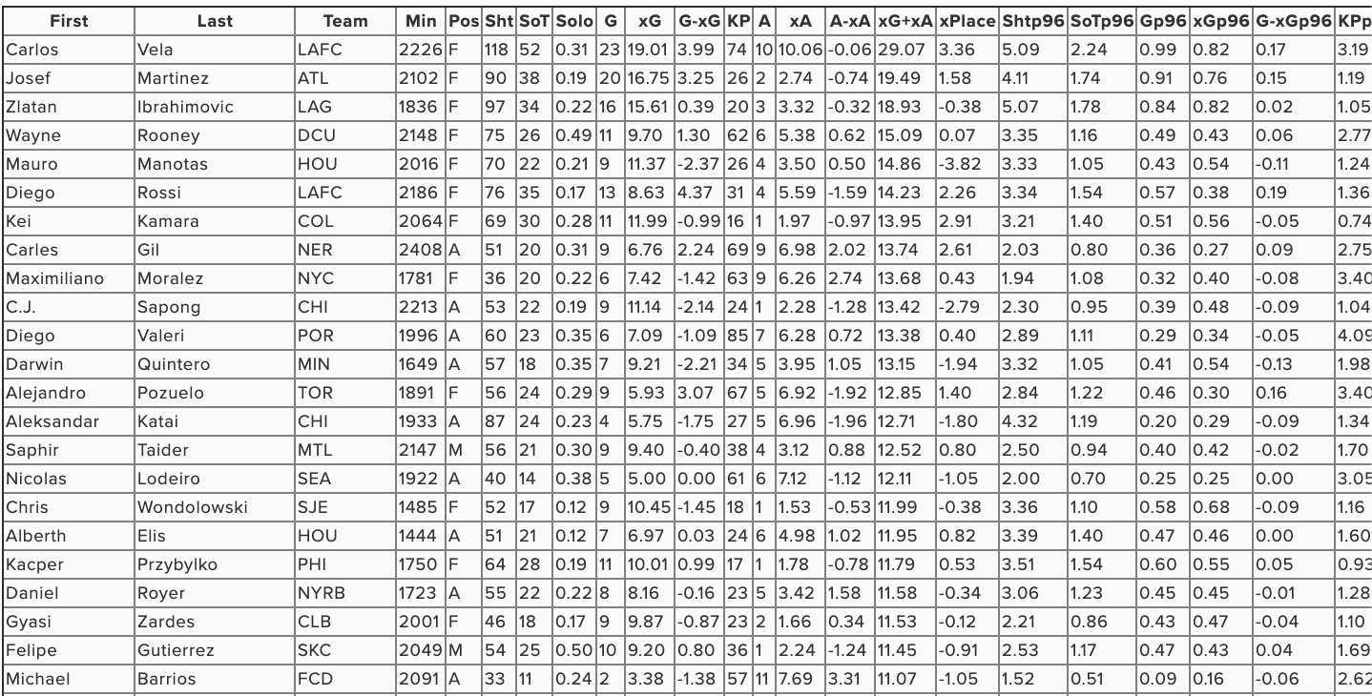
Obtain and Scrub : Scrape data from American Soccer Analysis, then clean and standardize

Slide 4
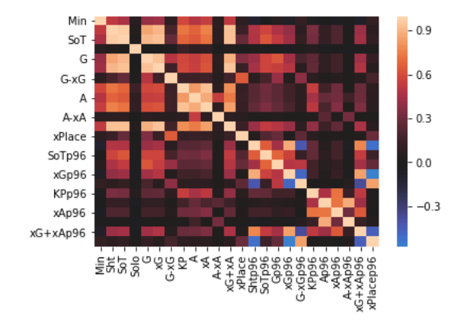
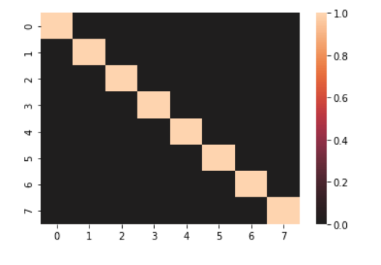
Explore: Heatmap correlation amongst features (PCA)
Before PCA
After PCA

Slide 5
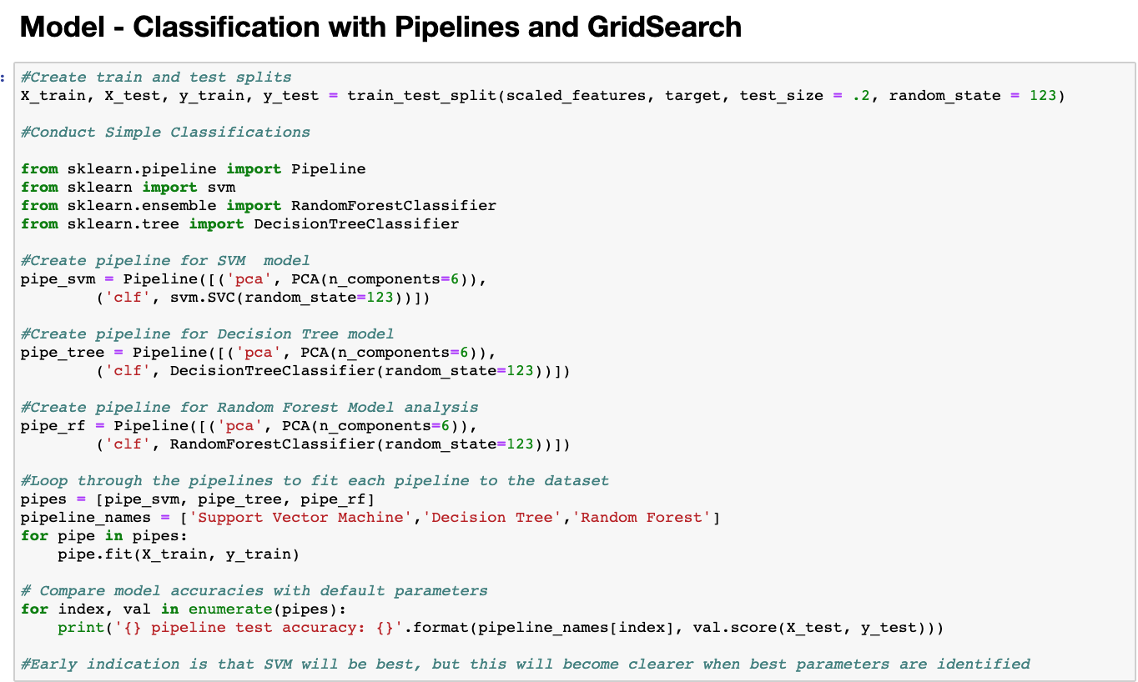
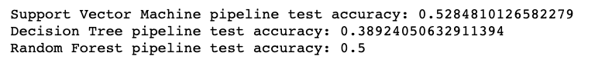
Model (Simple): Calculate explained variance for different classifiers using default settings

Slide 6
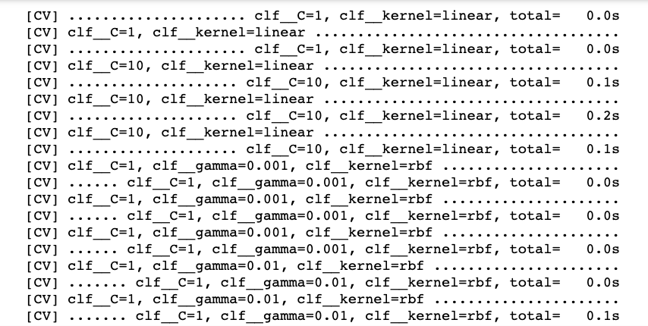
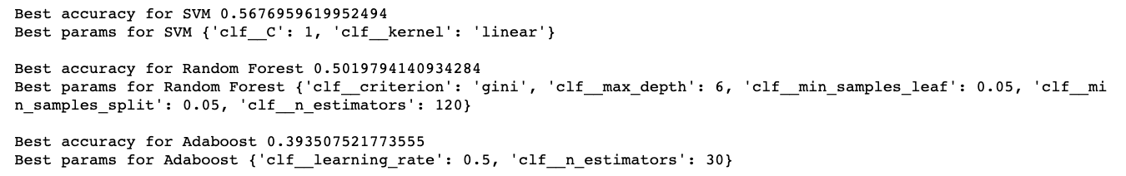
Model (Advanced): Calculate explained variance for different classifiers after testing for best parameters
Each line runs the classifier model with a different combination of parameters
Results: SVM with C = 1 and linear kernel explains 56.7% of variance

Slide 7
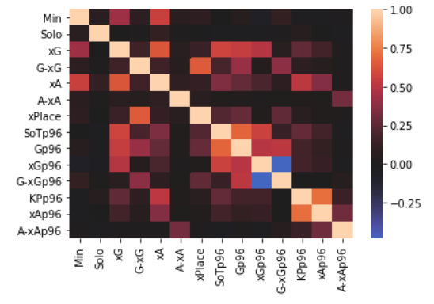
Validate: Heatmap correlation amongst features (multicollinearity < .75)
Before multicollinearity check
After multicollinearity check

Slide 8
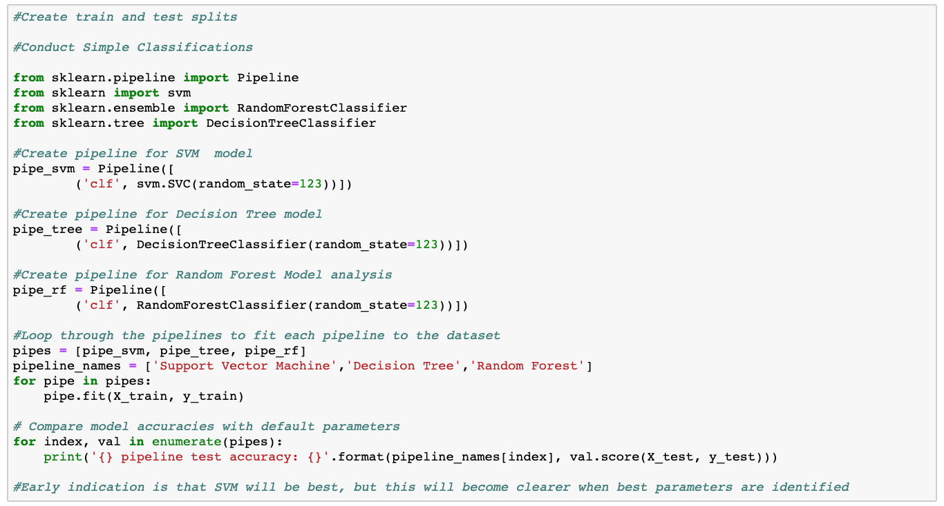
Validate (Simple): Calculate explained variance for different classifiers using default settings

Slide 9
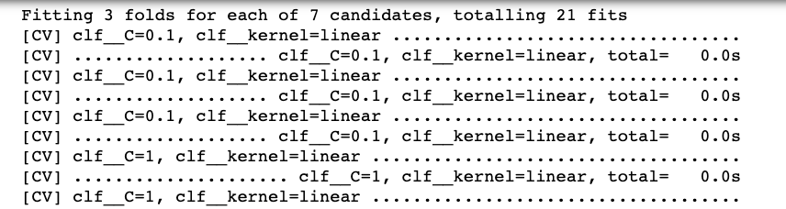
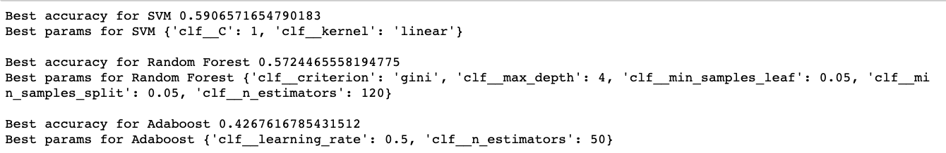
Validate (Advanced): Calculate explained variance for different classifiers after testing for best parameters
Each line runs the classifier model with a different combination of parameters
Results: SVM with C = 1 and linear kernel explains 59.1% of variance –
Greater Variance Explanation than PCA Model

Slide 10
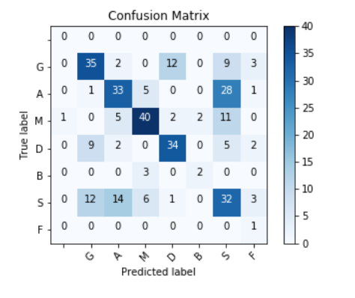
Interpret: Result and Visualization
SVM Classifier:
No PCA, C = 1, linear kernel
This model will predict the correct position based on advanced attacking metrics 56% of the time
Great improvement over 14.3% random guess

Slide 11
Interpret: Recommendations
Include GK metrics to isolate this position – surprisingly, mistakes were made identifying them based on offensive metrics
Include different/additional features to distinguish between attackers and strikers
Including defensive metrics to improve model accuracy
Sign undervalued/out-of-position from other leagues to play the position suggested by the model

Slide 12
Interpret: Project Takeaways
Scraping data is incredibly useful but one must have caution with security violation and time spent
PCA is a useful tool but not always the right answer – can reduce accuracy unnecessarily
Classification is a data science tool that should be at one’s disposal

Slide 13
Thank You
David Goldstein

